Slide 1
Future implications of generative ai

Slide 2
Problem
Generative AI usage increases and students take advantage, all the while fearing the loss of creativity and critical thinking skills.
Are generative tools such as ChatGPT diminishing creative exploration and leading students to rely less on their own cognitive function?

Slide 3
I'm ChatGPT—an AI developed by OpenAI. Think of me like a really smart, helpful assistant you can talk to about almost anything: answering questions, brainstorming ideas, writing stories, coding, learning new stuff, or just chatting. You can get as casual or as deep as you want with me.
ChatGPT
Are you Generative AI?
Yep, I am! I'm a generative AI, which means I can create (or "generate") content like text, images, code, and more based on the input you give me. My specialty is language, so I’m particularly good at writing, explaining, translating, summarizing, and chatting like this.
If you’re curious: I’m based on a large language model called GPT-4, trained on tons of text to learn how to respond in a way that (hopefully) feels natural and helpful.
What are you?

Slide 4
Students and the use of Generative AI
Higher Education Policy Institute (HEPI)
Student Generative AI Survey 2025
“According to the policy report, the survey for 2025 found that student use of AI had surged in the last year, with 92% now using AI in some form – up from 66% in 2024 – and 88% having used GenAI for assessments, compared to 53% in 2024.” (Source 2)

Slide 5
Science Direct: How does generative Ai impact students?
Positive Opinions on Gen AI
Negative Opinions on Gen AI
“Without the AI generator ideas were initially hard to come up with and then as I generated ideas, I was able to snowball more ideas. The AI generator helped me initiate ideas.”
“It is helpful to have another ‘brain’ to bring more ideas to the topic and not just one perspective.”
“What I found was that ChatGPT came up with ideas that I would have never even considered…. As AI and technology such as ChatGPT continue to advance, I think we can use it in tandem with our own brainstorming to improve overall innovation.”
(Source 1)
“The use of the AI was nice, but in some ways feels like taking ‘the easy way out.’”
“It felt as though the bot was giving me an easy way out and not allowing me to think on my own as much.”
"AI came up with those ideas so easily, and I felt bad that I didn't come up with more ideas myself.”
(Source 1)

Slide 6
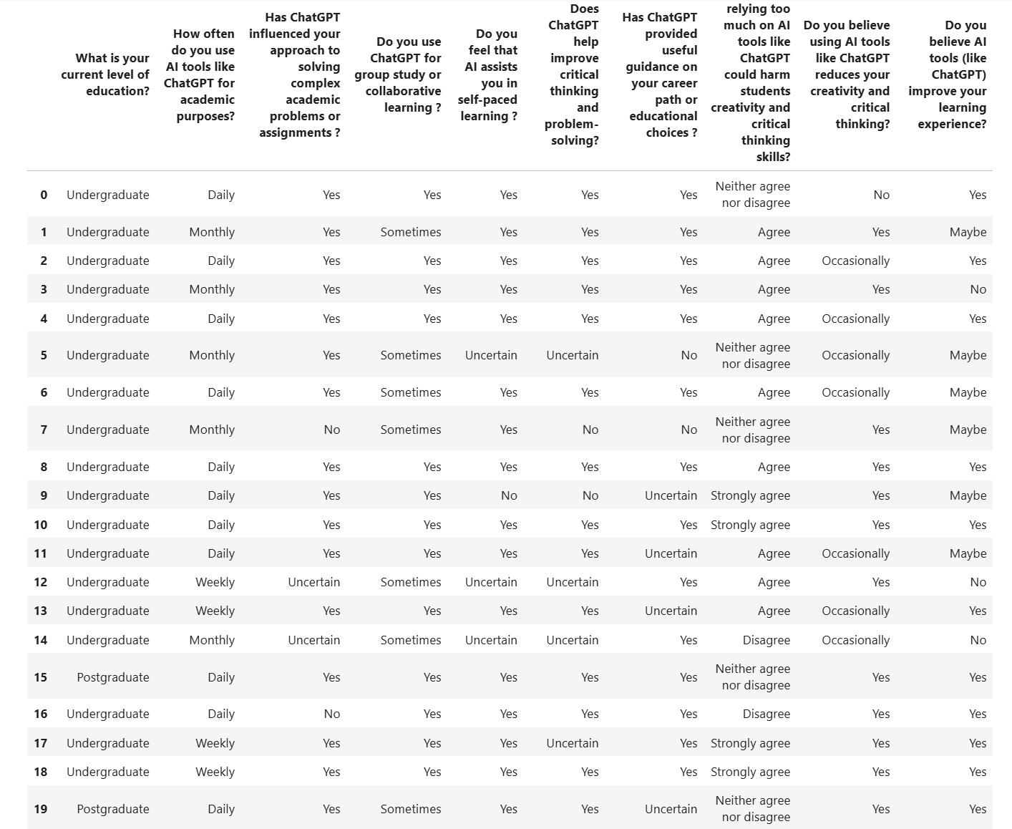
Dataset
Impact of Gen AI and ChatGPT on Bangladeshi Students
Bangladeshi undergraduate, postgraduate, and PhD students from various universities responded to a questionnaire regarding their thoughts on generative AI tool ChatGPT.
They provided feedback on their use of this tool as well as the effects it may have on their cognitive skills.

Slide 7
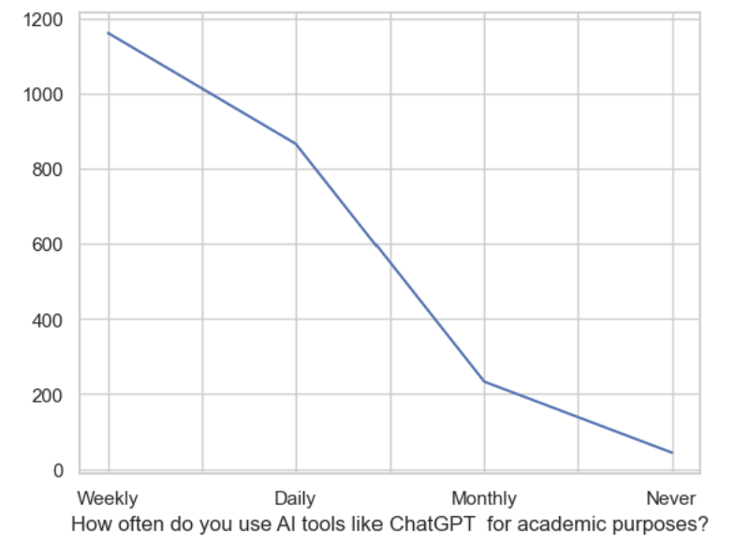
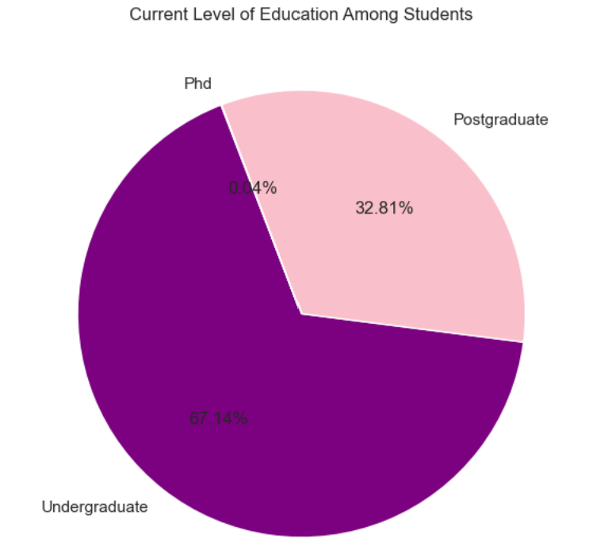
Use of Generative AI
Students

Slide 8
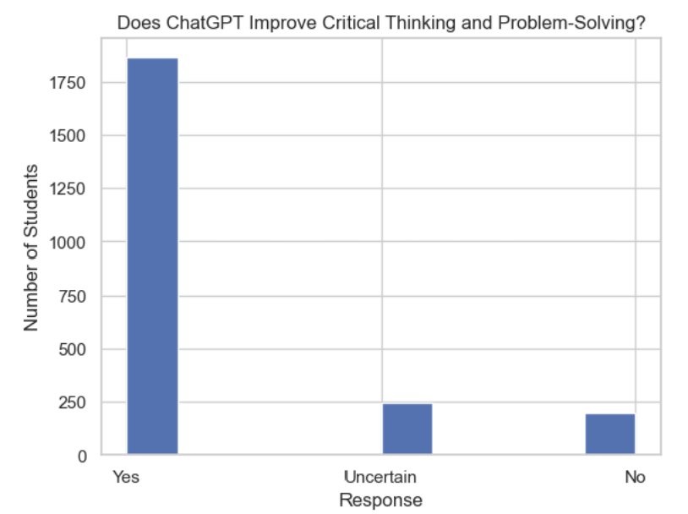
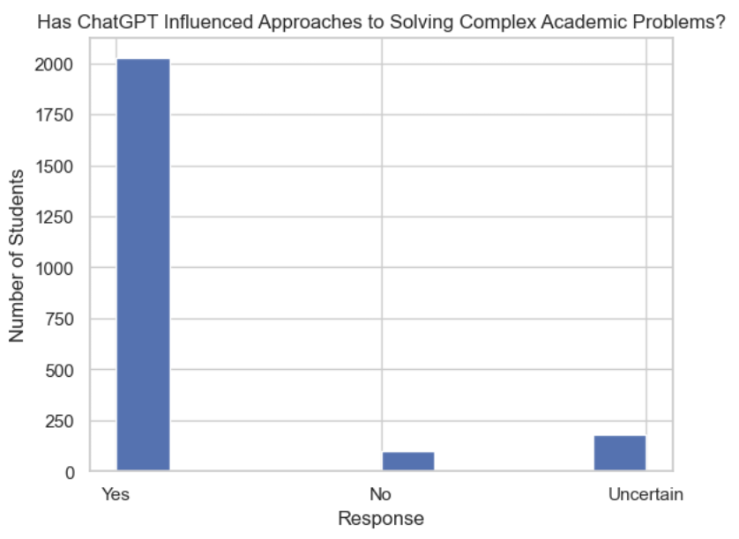
Usefulness of ChatGPT

Slide 9
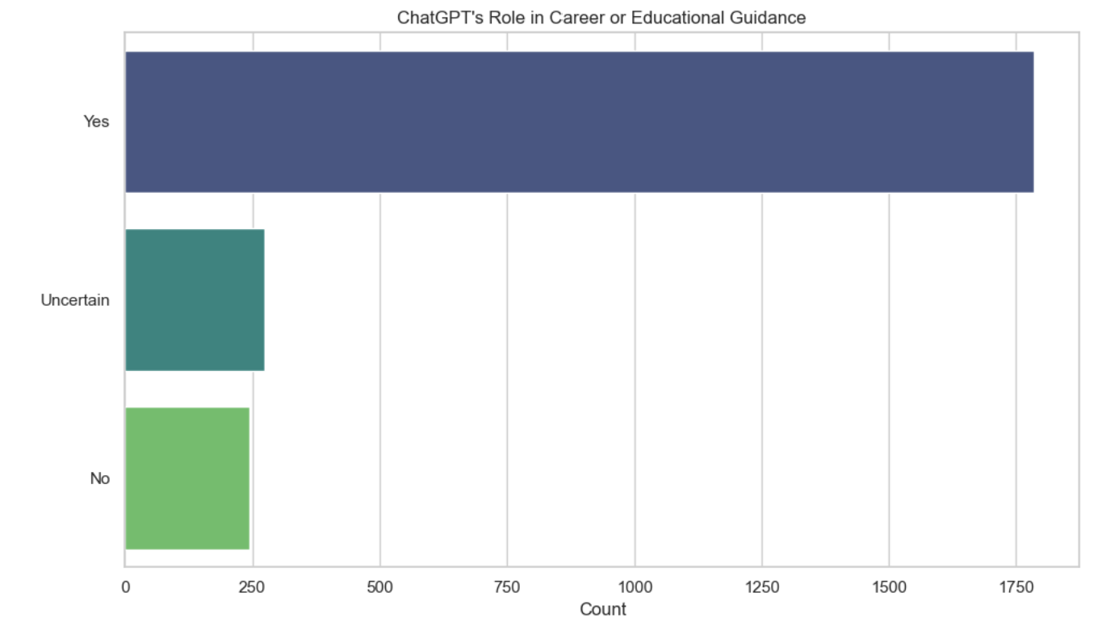
Has ChatGPT provided useful guidance on your career path or educational choices ?

Slide 10
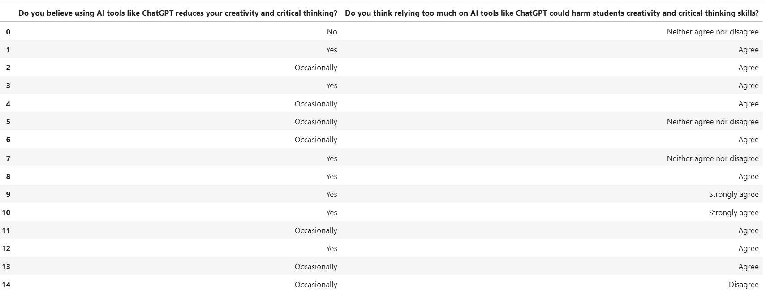
impact of Generative AI on Creativity and Critical Thinking
Students provided their feedback regarding the negative impact ChatGPT may have on their cognitive skills.
Most believe that reliance of generative AI could reduce or harm creativity and critical thinking.

Slide 11
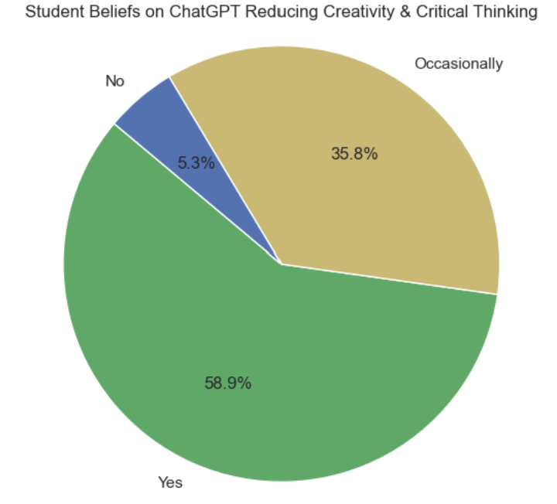
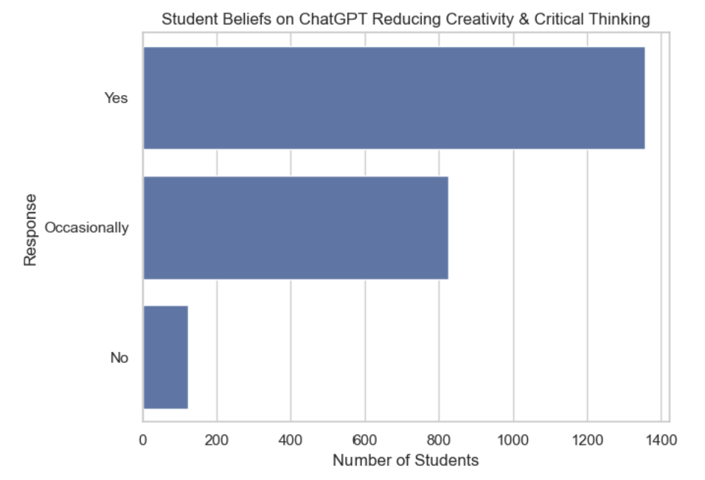
Cognitive Skills: Impact on Creativity and Critical Thinking

Slide 12
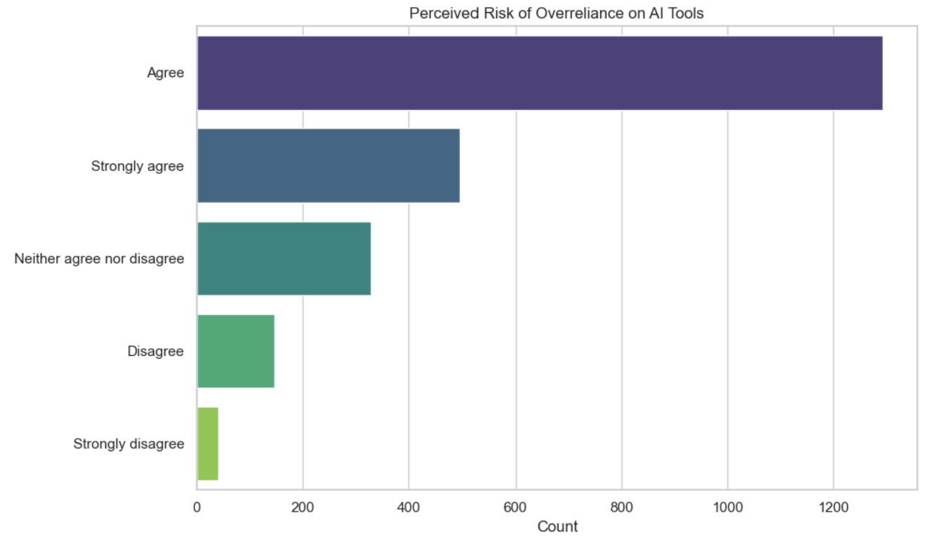
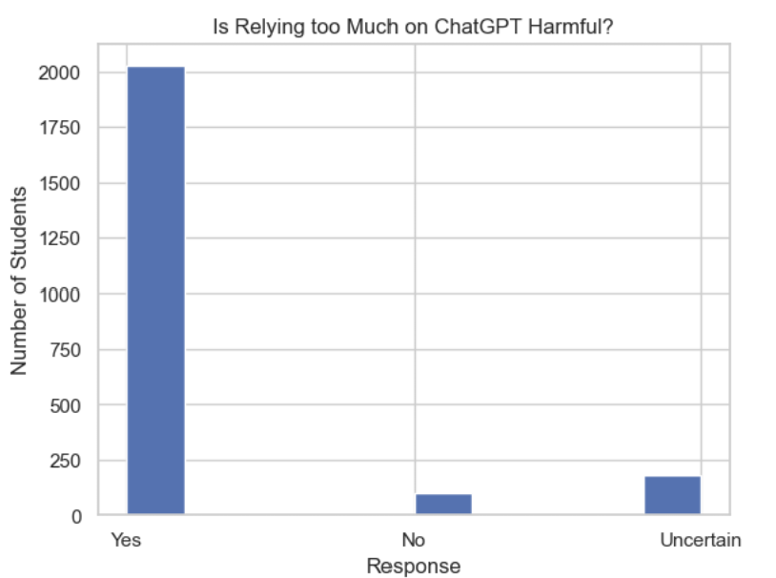
Is Relying on ChatGPT Harmful to creativity and critical thinking?

Slide 13
Other Implications
“Teachers also reported in the same survey that students are increasingly getting in trouble for using AI to complete assignments. In the 2023-24 school year, 63 percent of teachers said students had gotten in trouble for being accused of using generative AI in their schoolwork, up from 48 percent last school year.” (Source 3)
The above excerpt is from an Educationweek article regarding an increase in cheating with AI. The study is based on middle and high school students. Though AI has been significant on the education front, it has also increased cheating. This may suggest that younger generations may rely less on themselves and more on technology to learn and improve.
The idea of the future being maintained by AI and not humans is becoming more fathomable; the students that are discussed in this project are the future generations that will eventually lead. What kind of world will that be? Will AI become a more common source of knowledge and insight than the human mind? People must foster positive connections between self-reliance and technology, and this begins in the classroom.

Slide 14
Sources
How does generative artificial intelligence impact student creativity? – ScienceDirect (Source 1)
AI use by students surges to 92%, second HEPI survey finds (Source 2)
New Data Reveal How Many Students Are Using AI to Cheat (Source 3)
Impact of AI and ChatGPT on Bangladeshi Students (Dataset)

